Slide 1
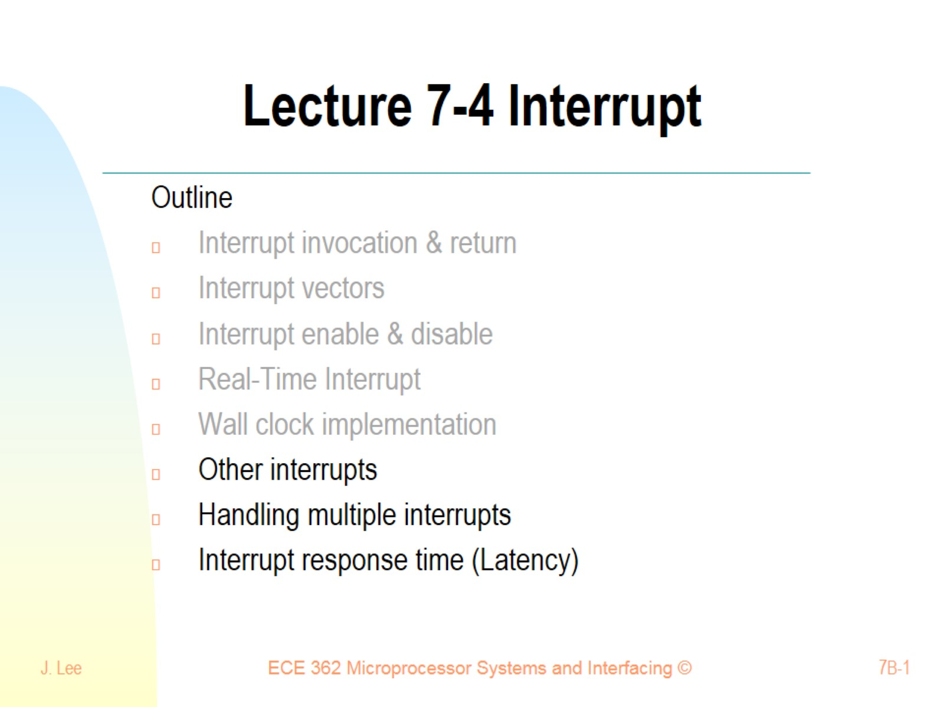
Lecture 7-4 Interrupt

Slide 2
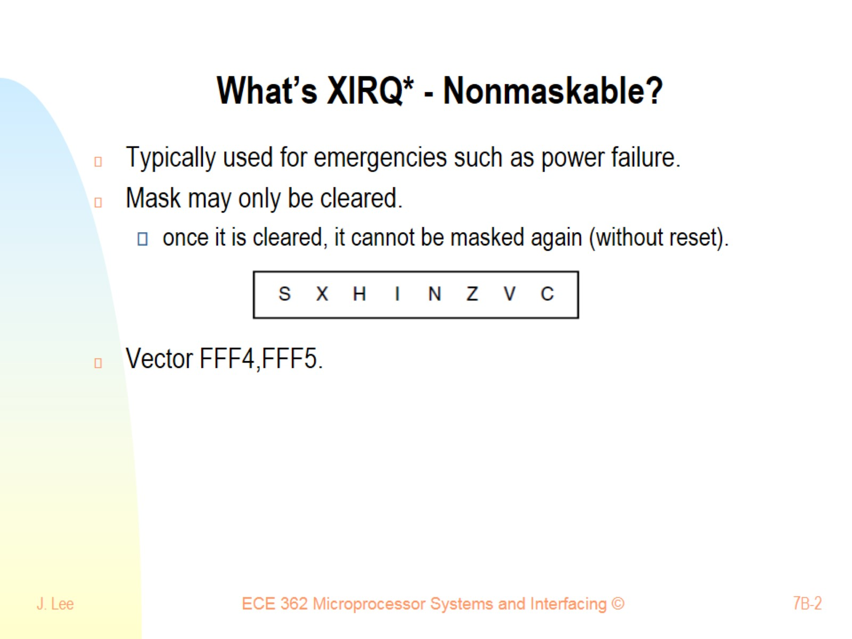
What’s XIRQ* - Nonmaskable?

Slide 3
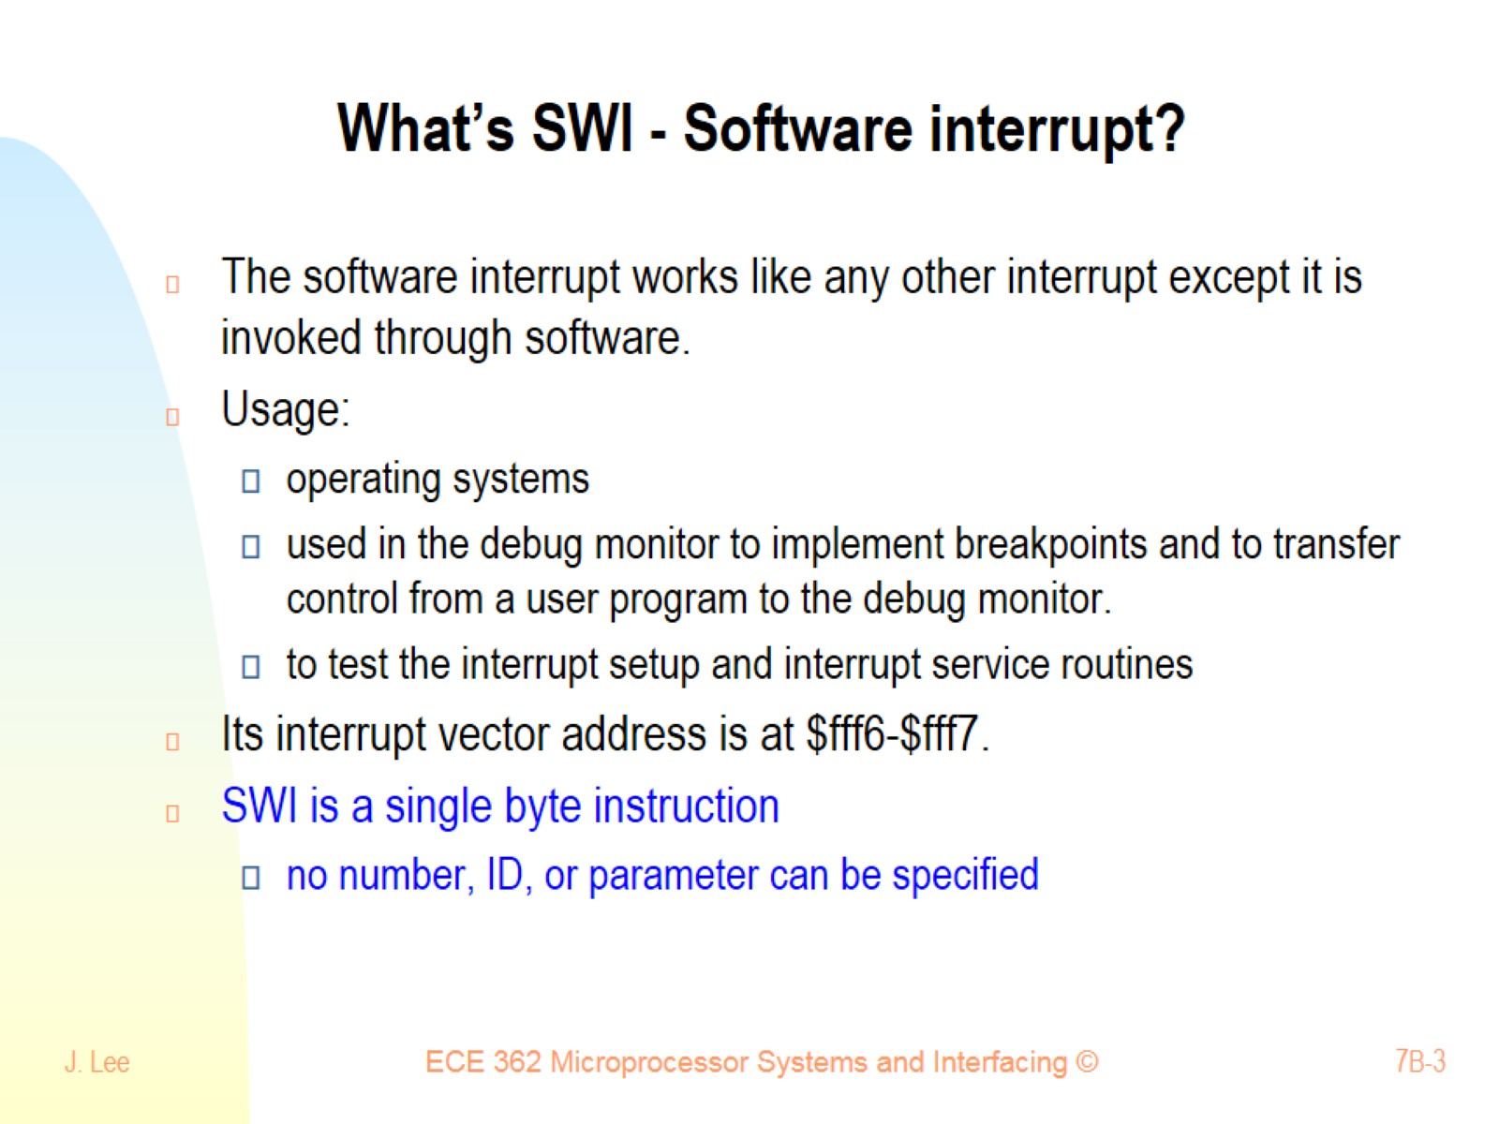
What’s SWI - Software interrupt?

Slide 4
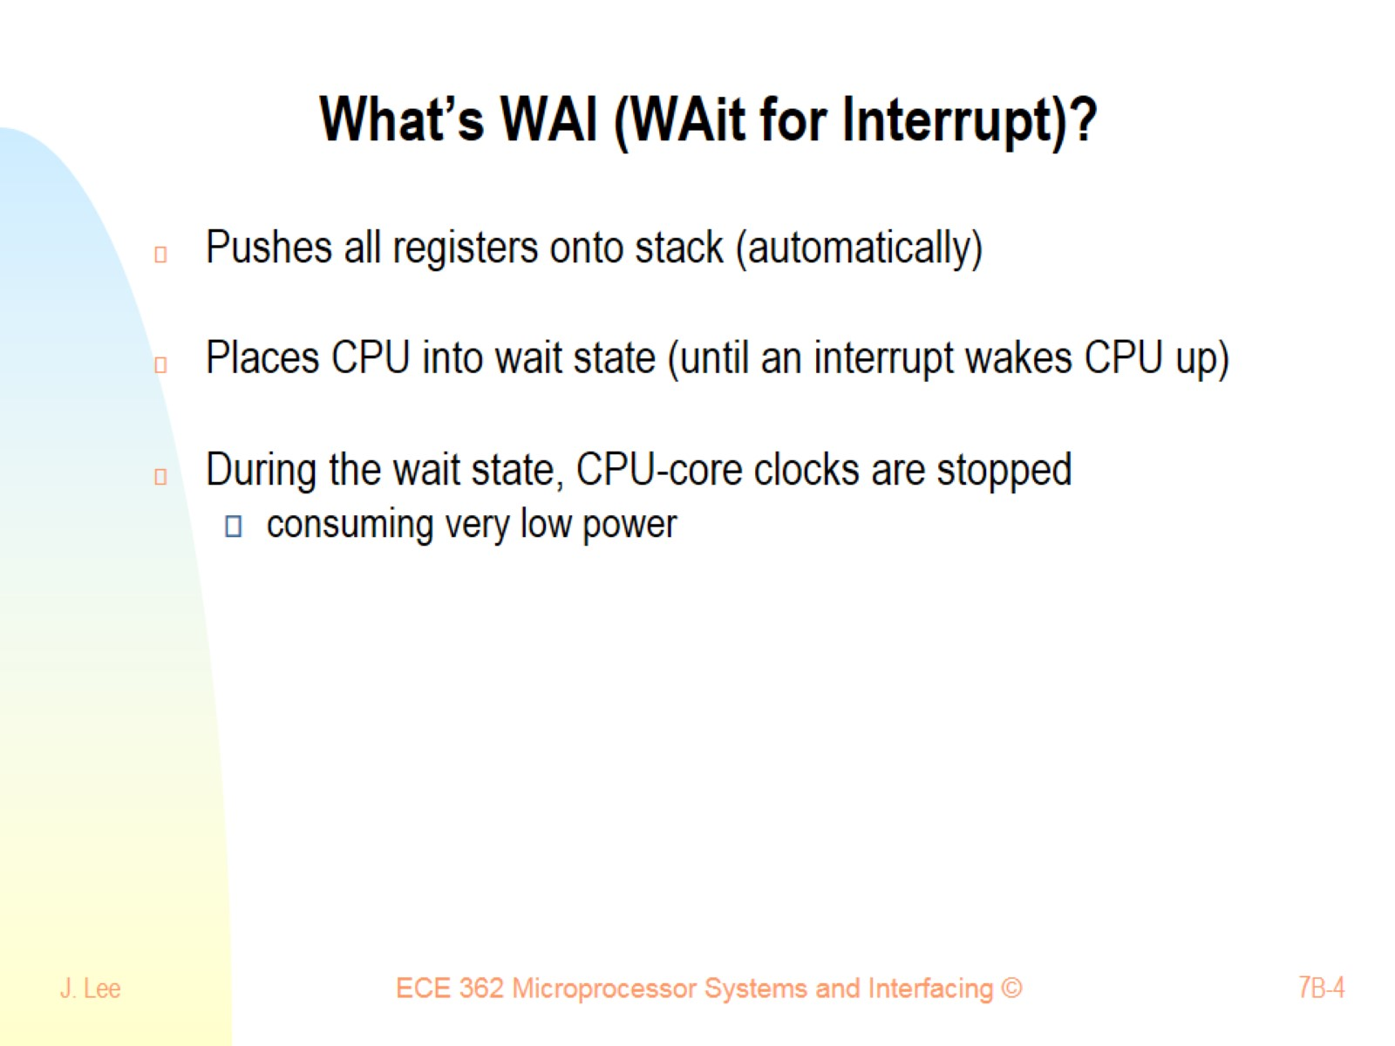
What’s WAI (WAit for Interrupt)?

Slide 5
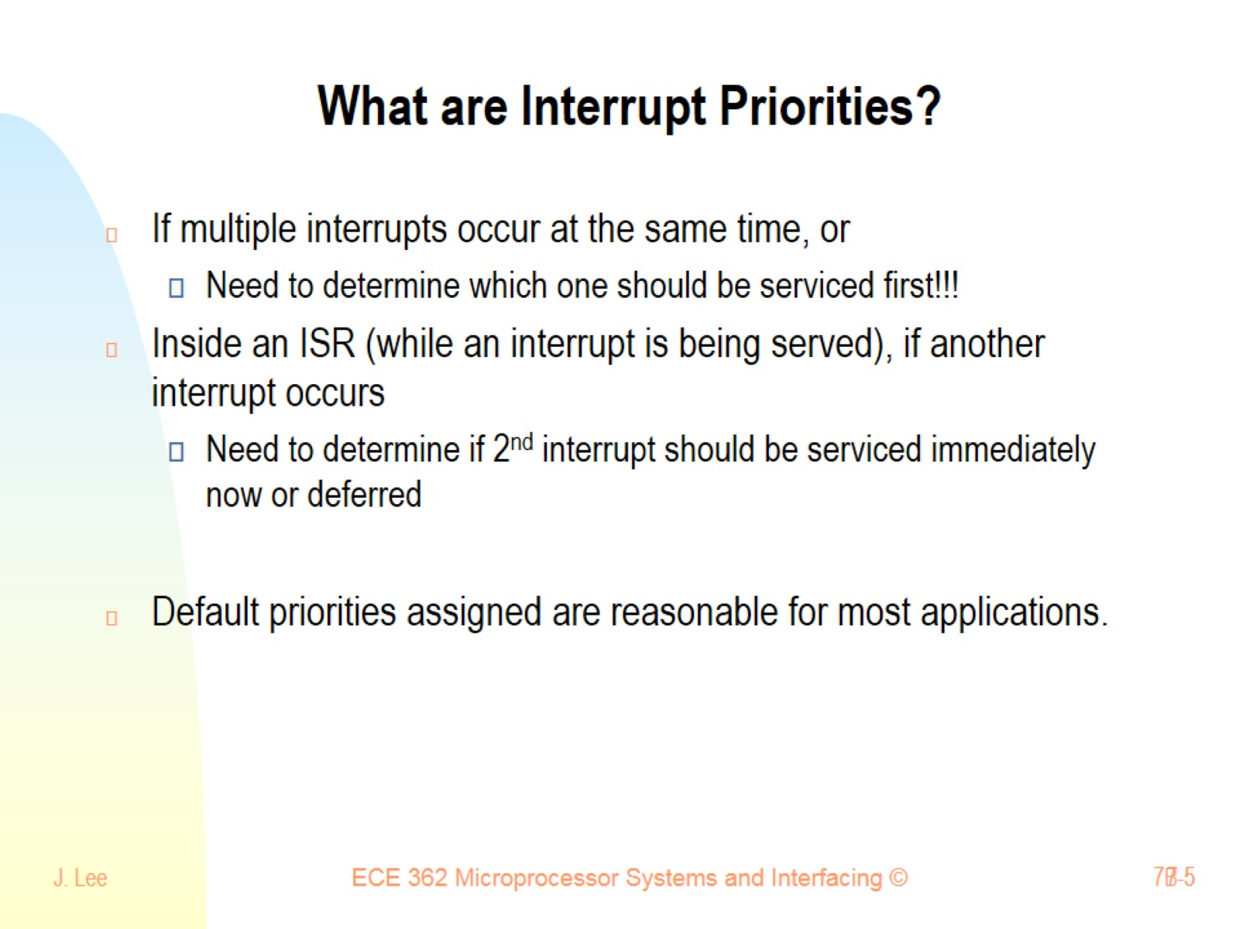
What are Interrupt Priorities?

Slide 6
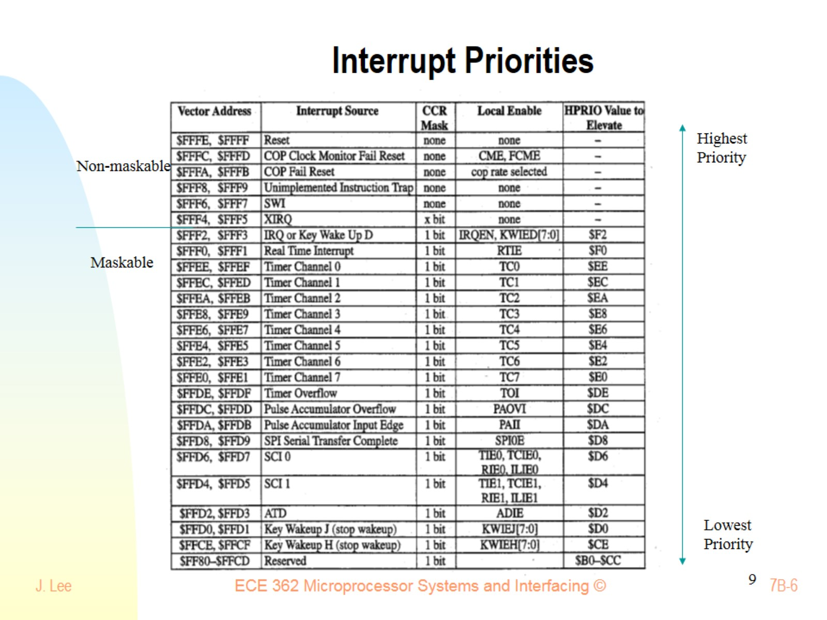
Interrupt Priorities

Slide 7
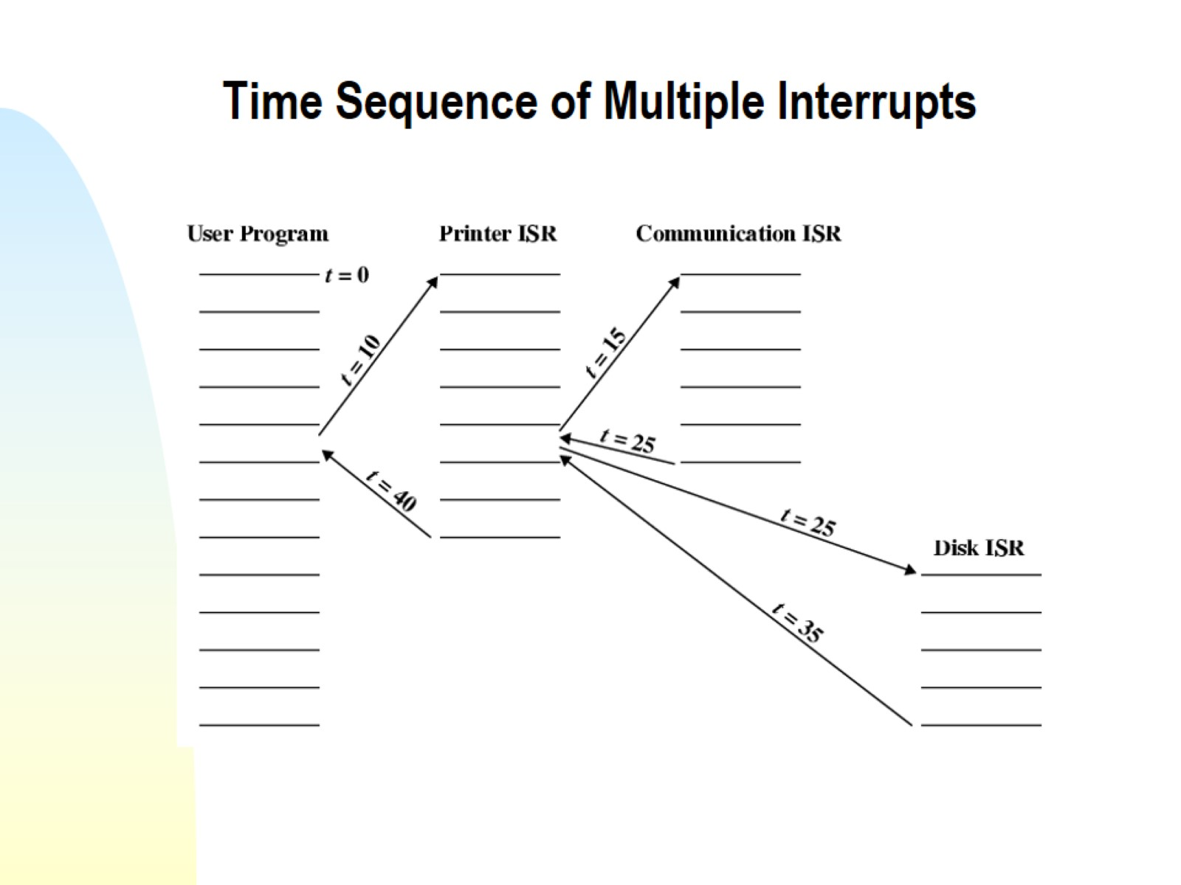
Time Sequence of Multiple Interrupts

Slide 8
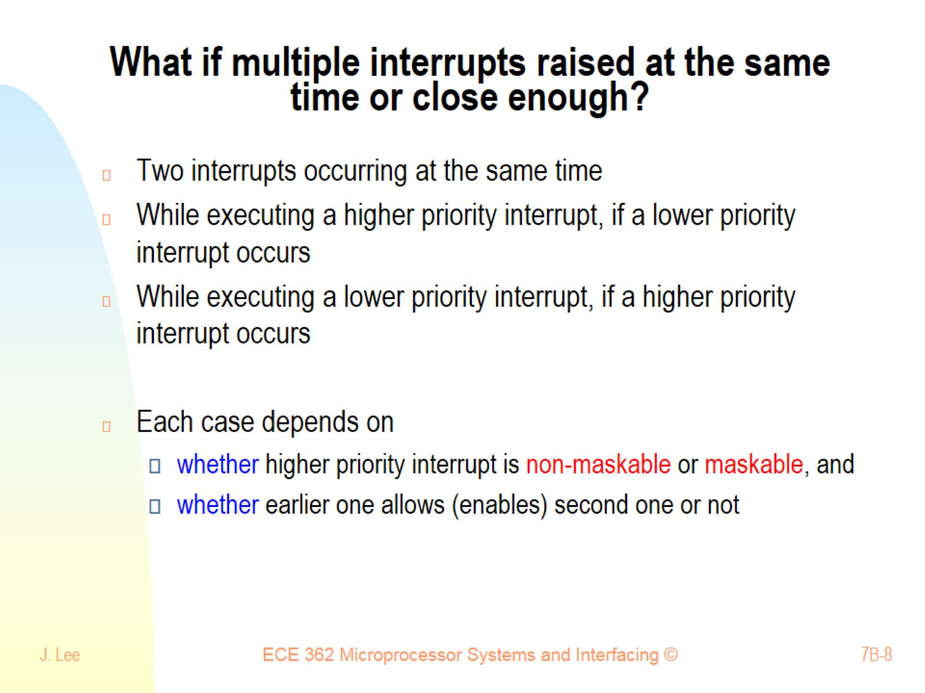
What if multiple interrupts raised at the same time or close enough?

Slide 9
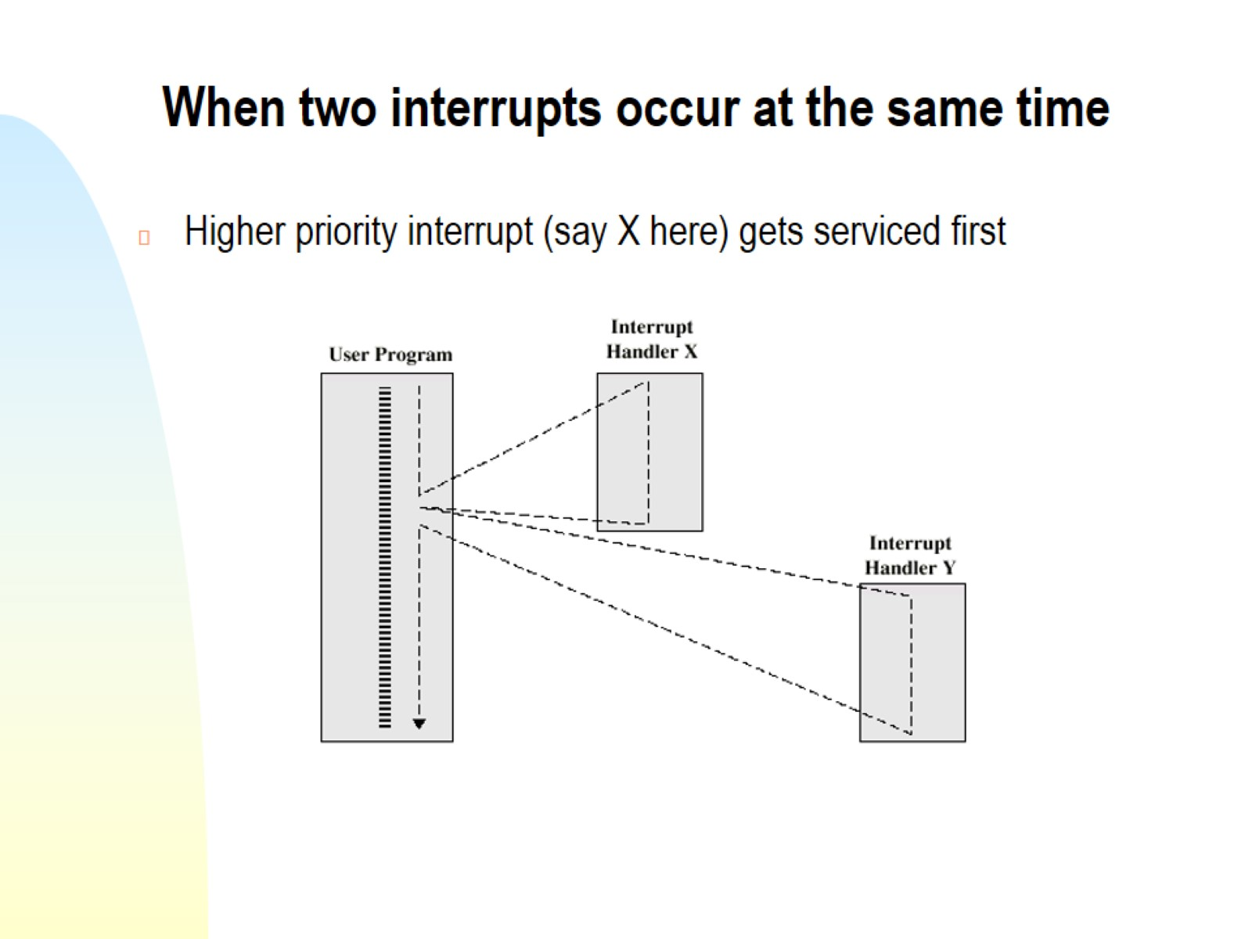
When two interrupts occur at the same time

Slide 10
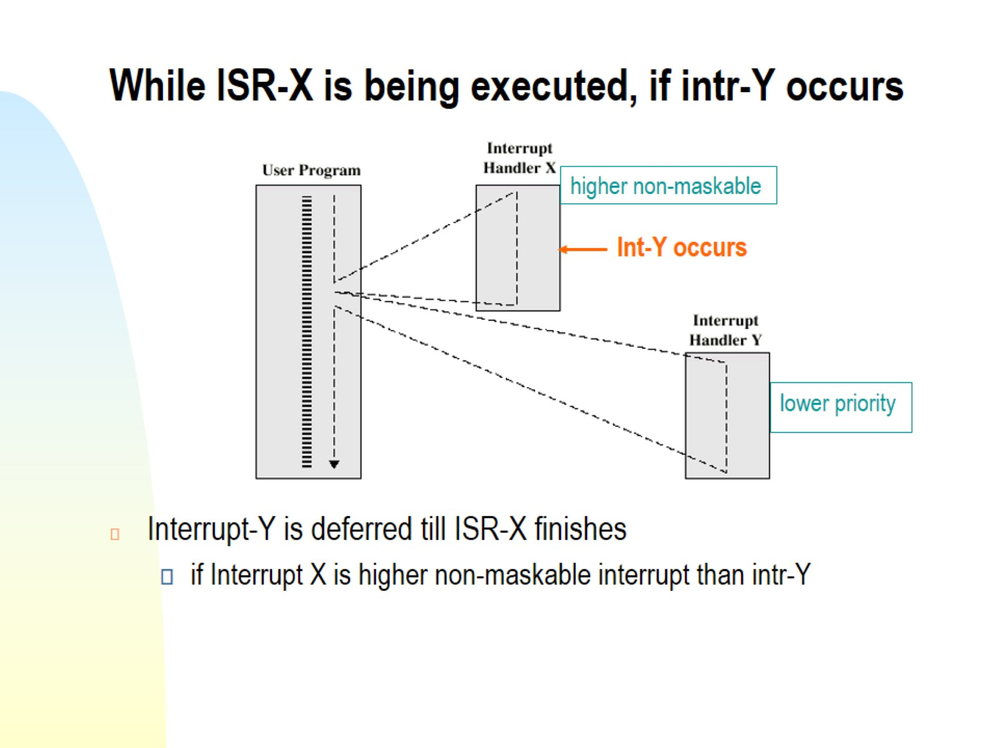
While ISR-X is being executed, if intr-Y occurs

Slide 11
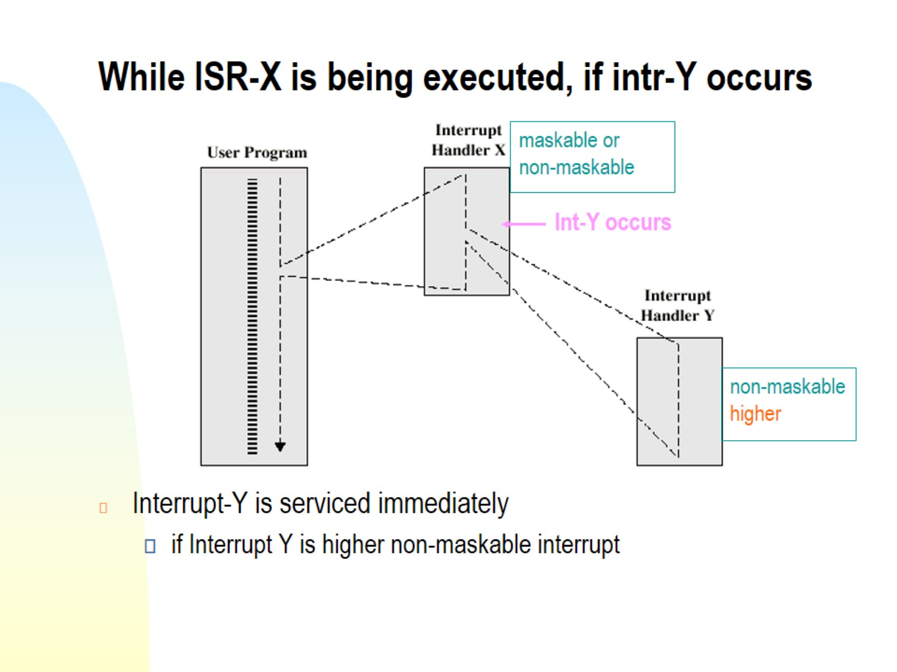
While ISR-X is being executed, if intr-Y occurs

Slide 12
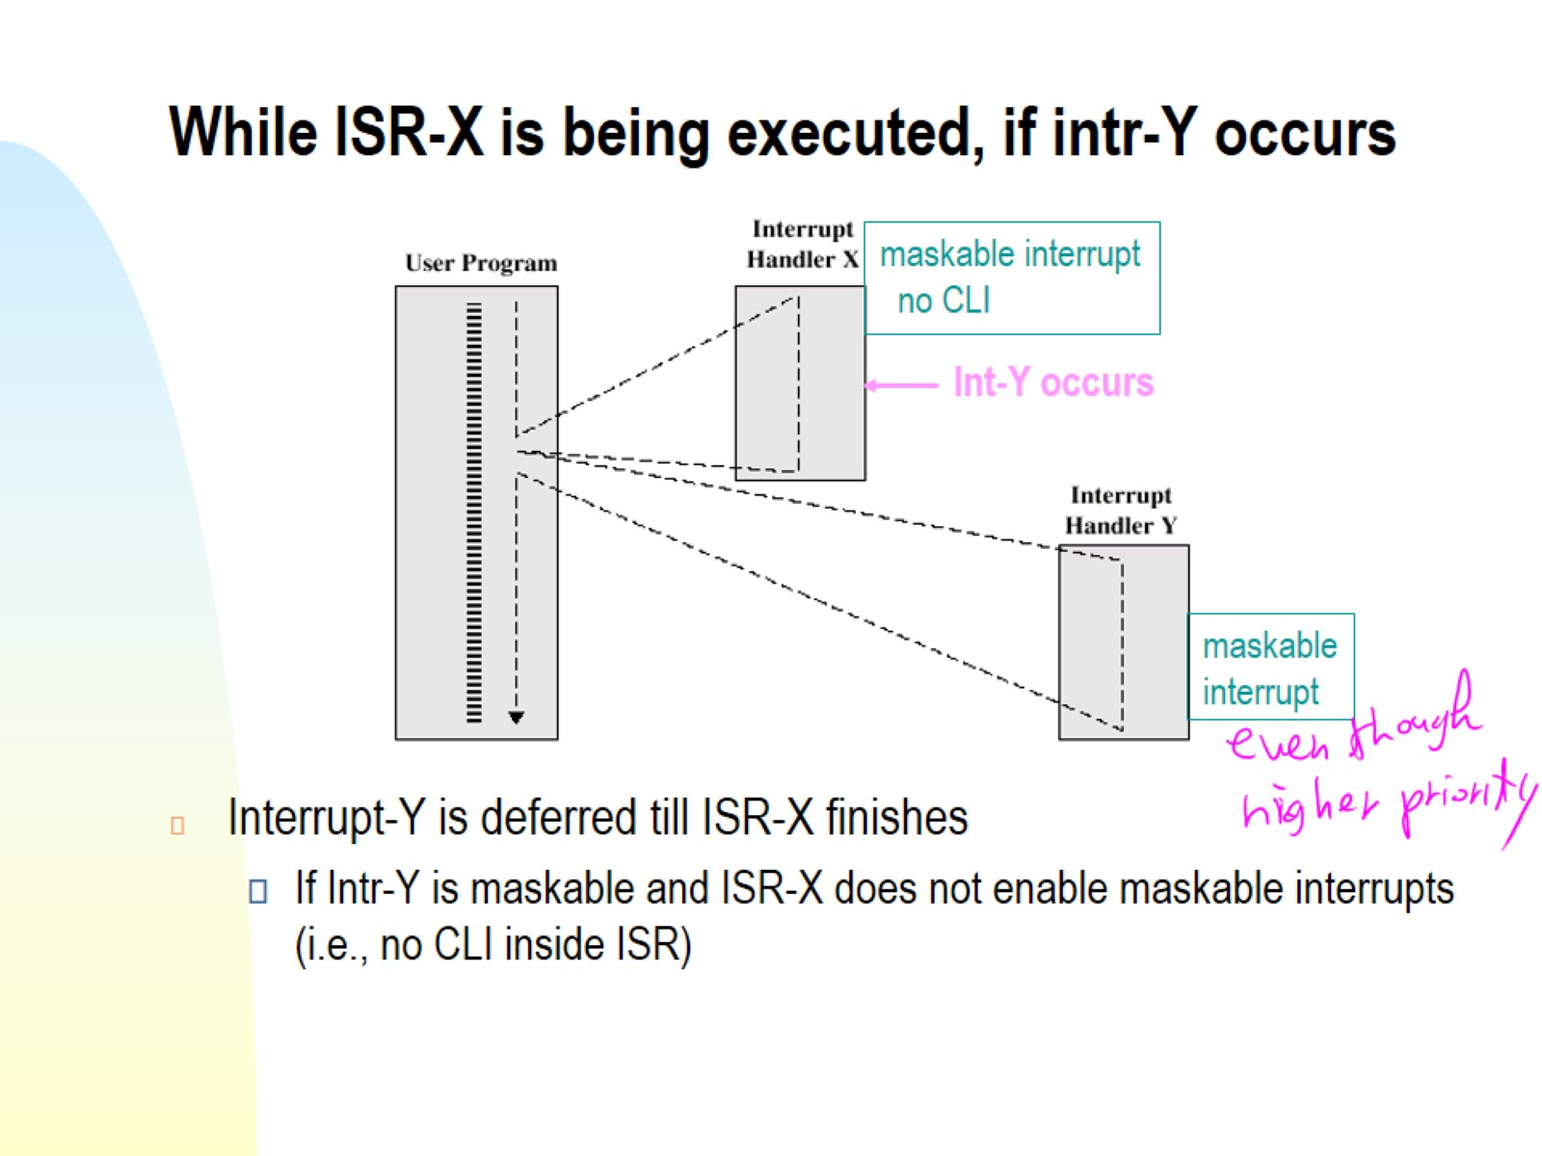
While ISR-X is being executed, if intr-Y occurs

Slide 13
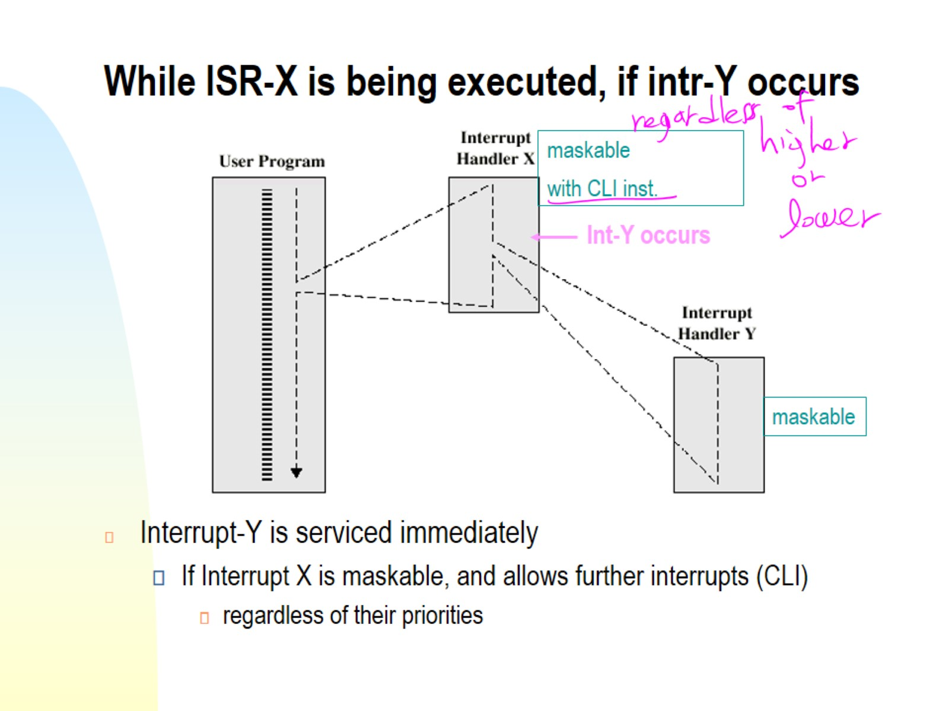
While ISR-X is being executed, if intr-Y occurs

Slide 14
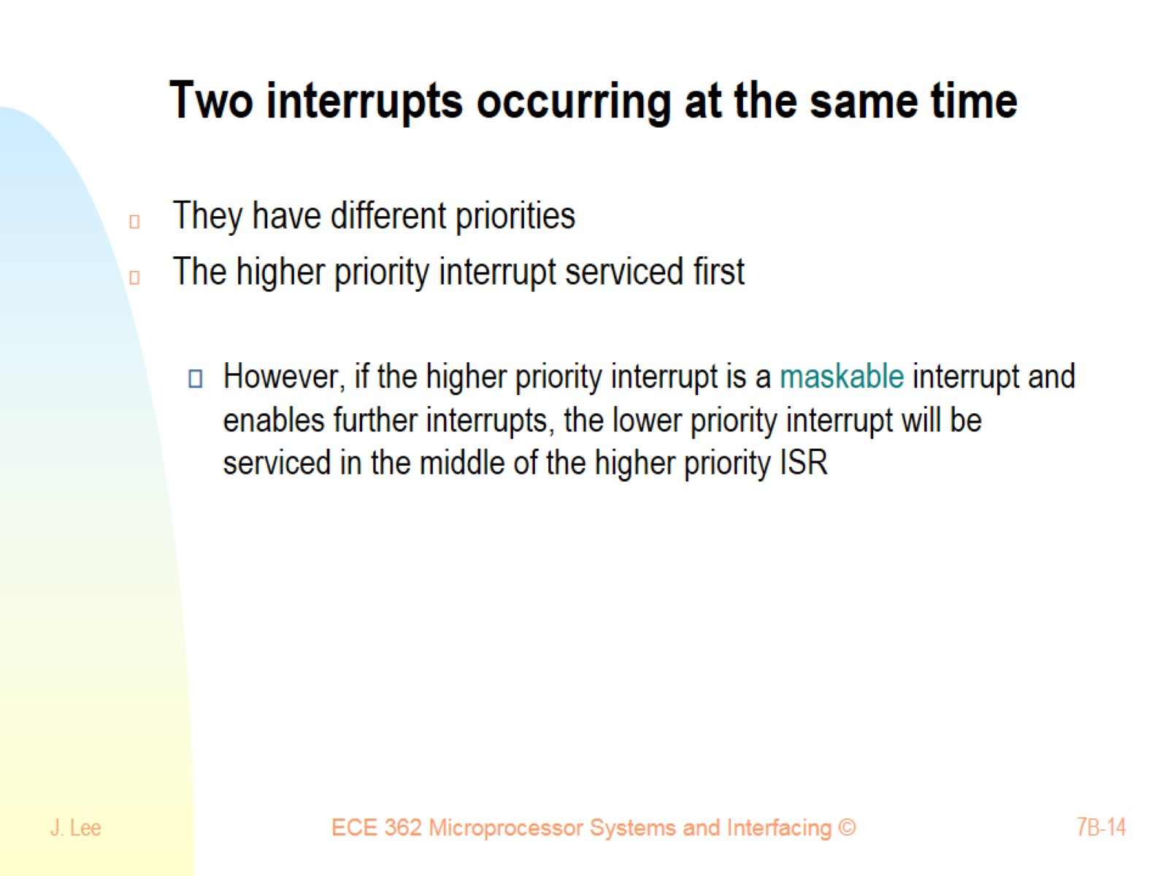
Two interrupts occurring at the same time

Slide 15
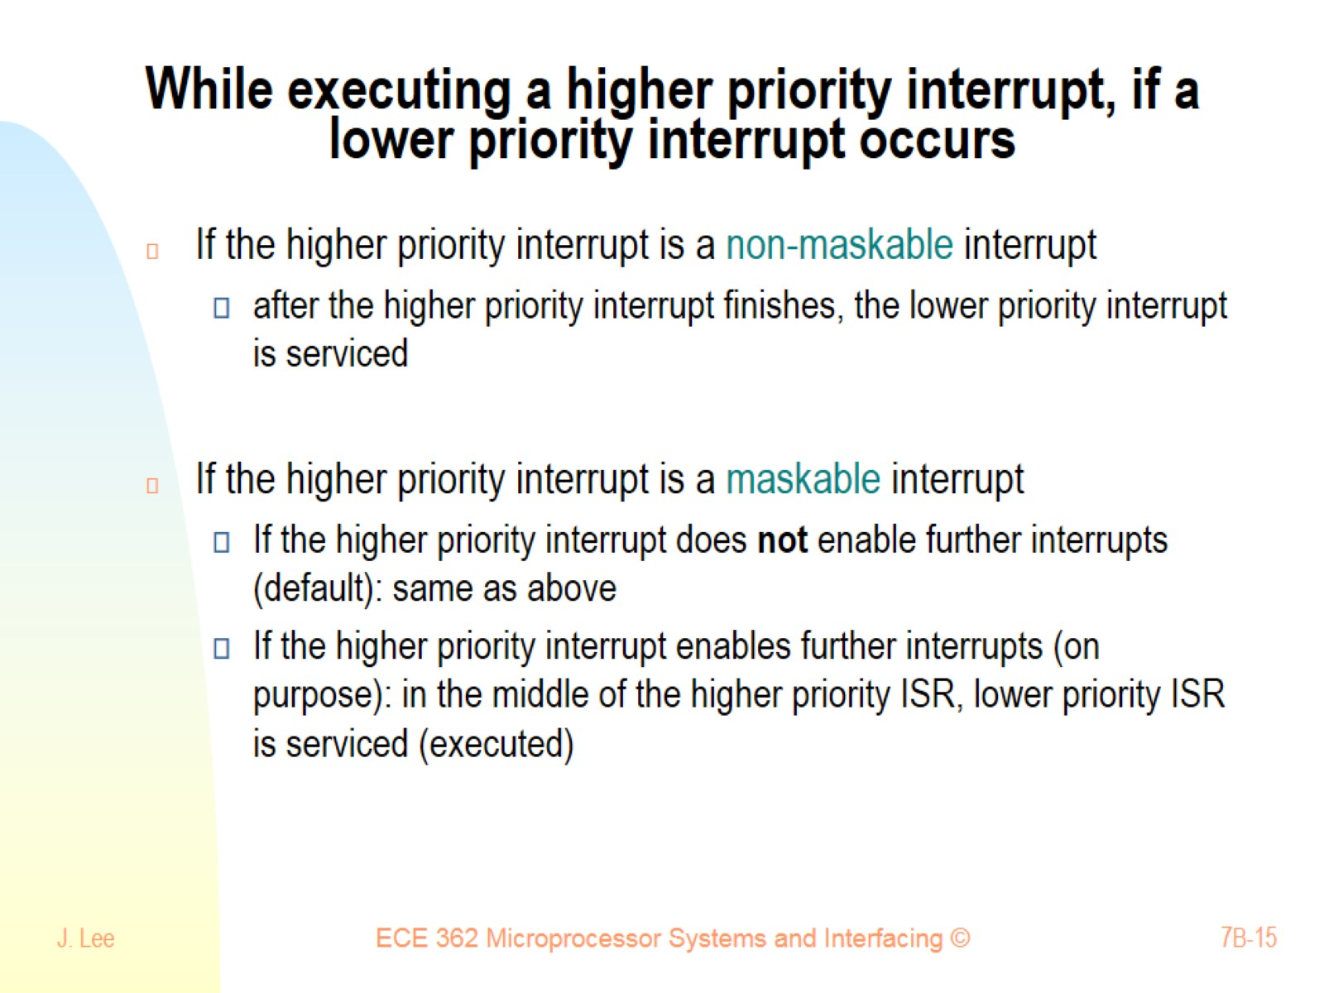
While executing a higher priority interrupt, if a lower priority interrupt occurs

Slide 16
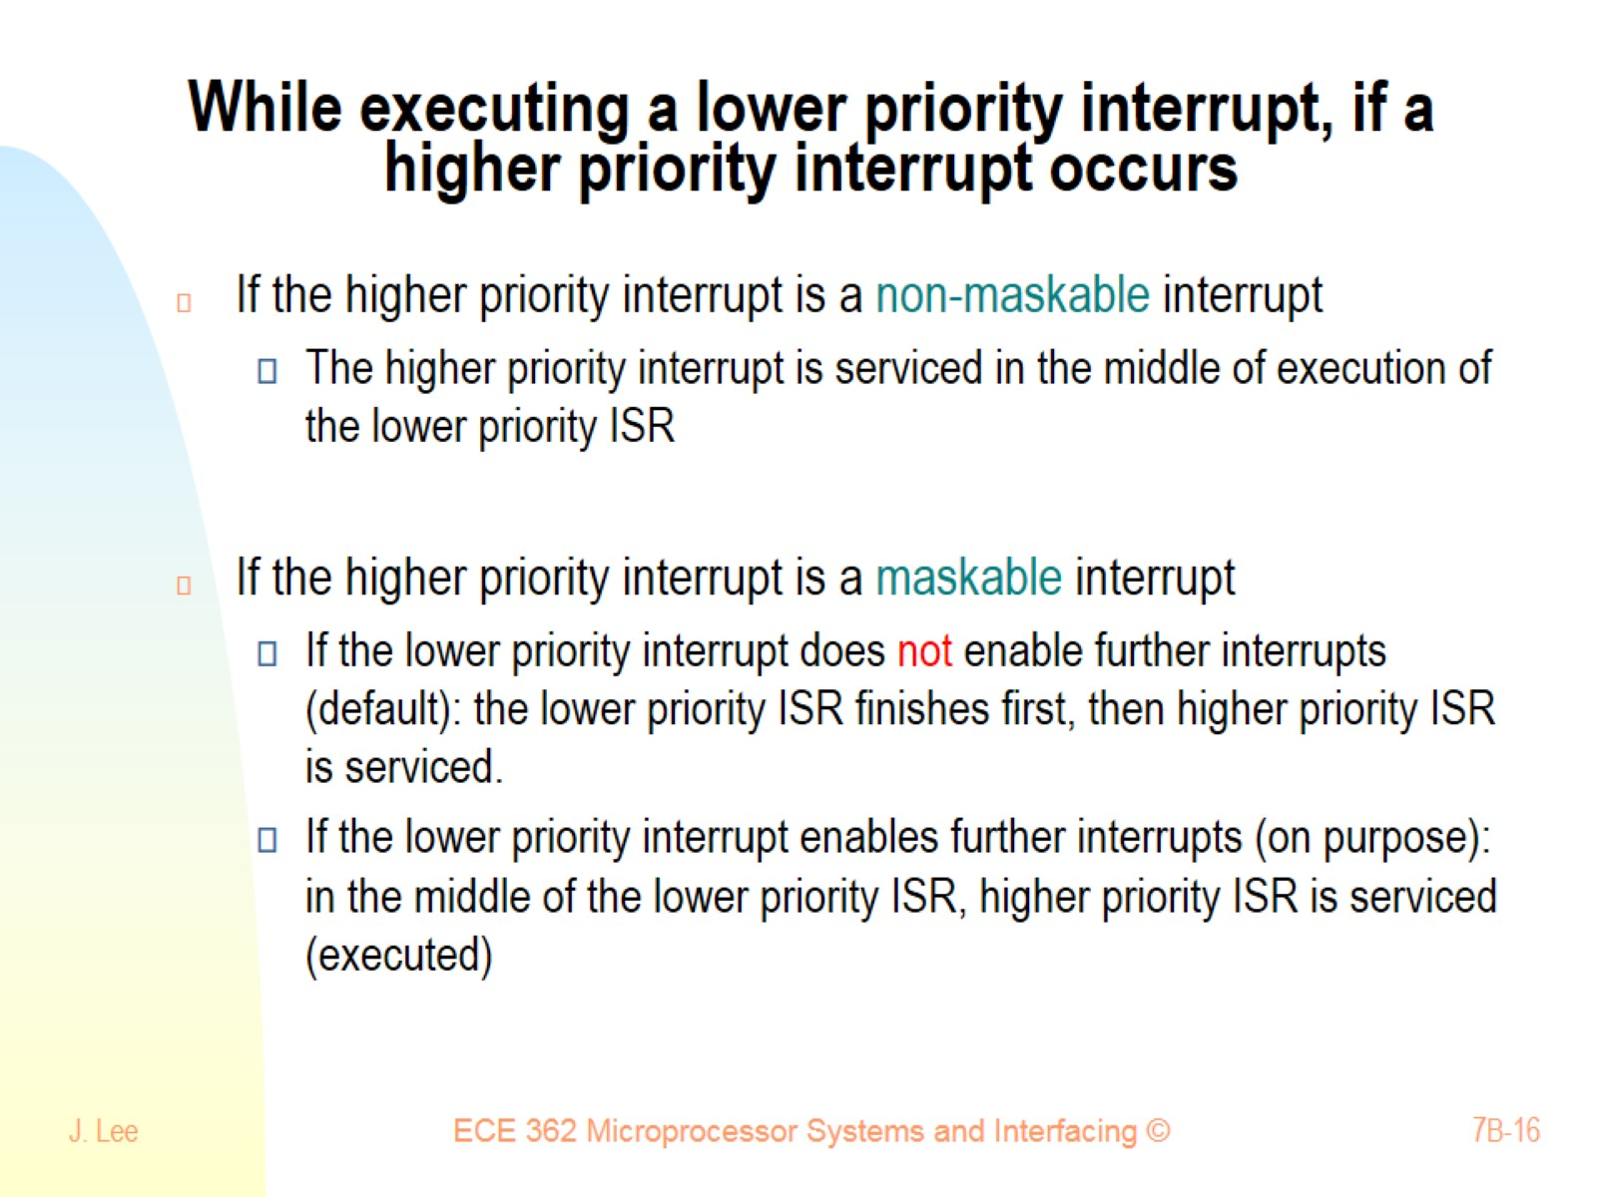
While executing a lower priority interrupt, if a higher priority interrupt occurs

Slide 17
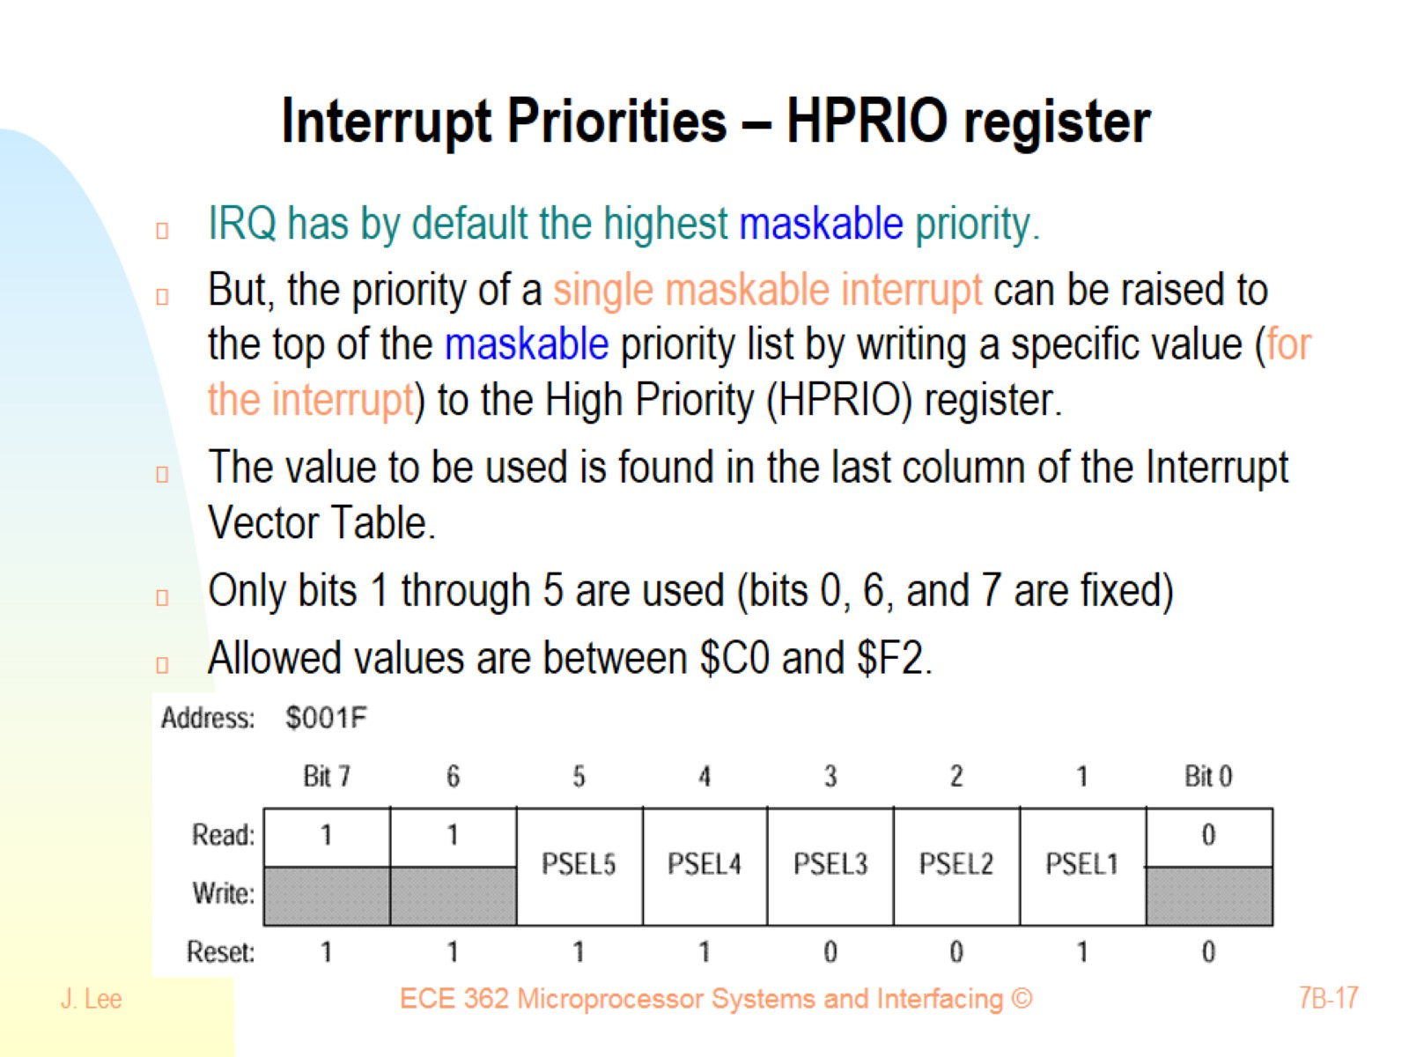
Interrupt Priorities – HPRIO register

Slide 18
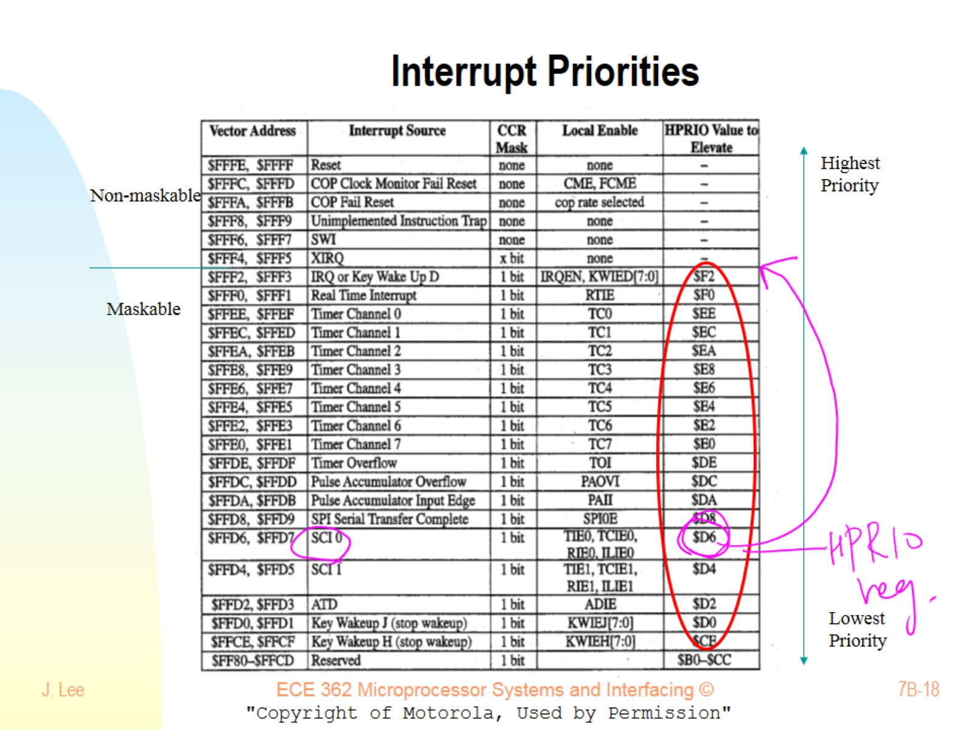
Interrupt Priorities

Slide 19
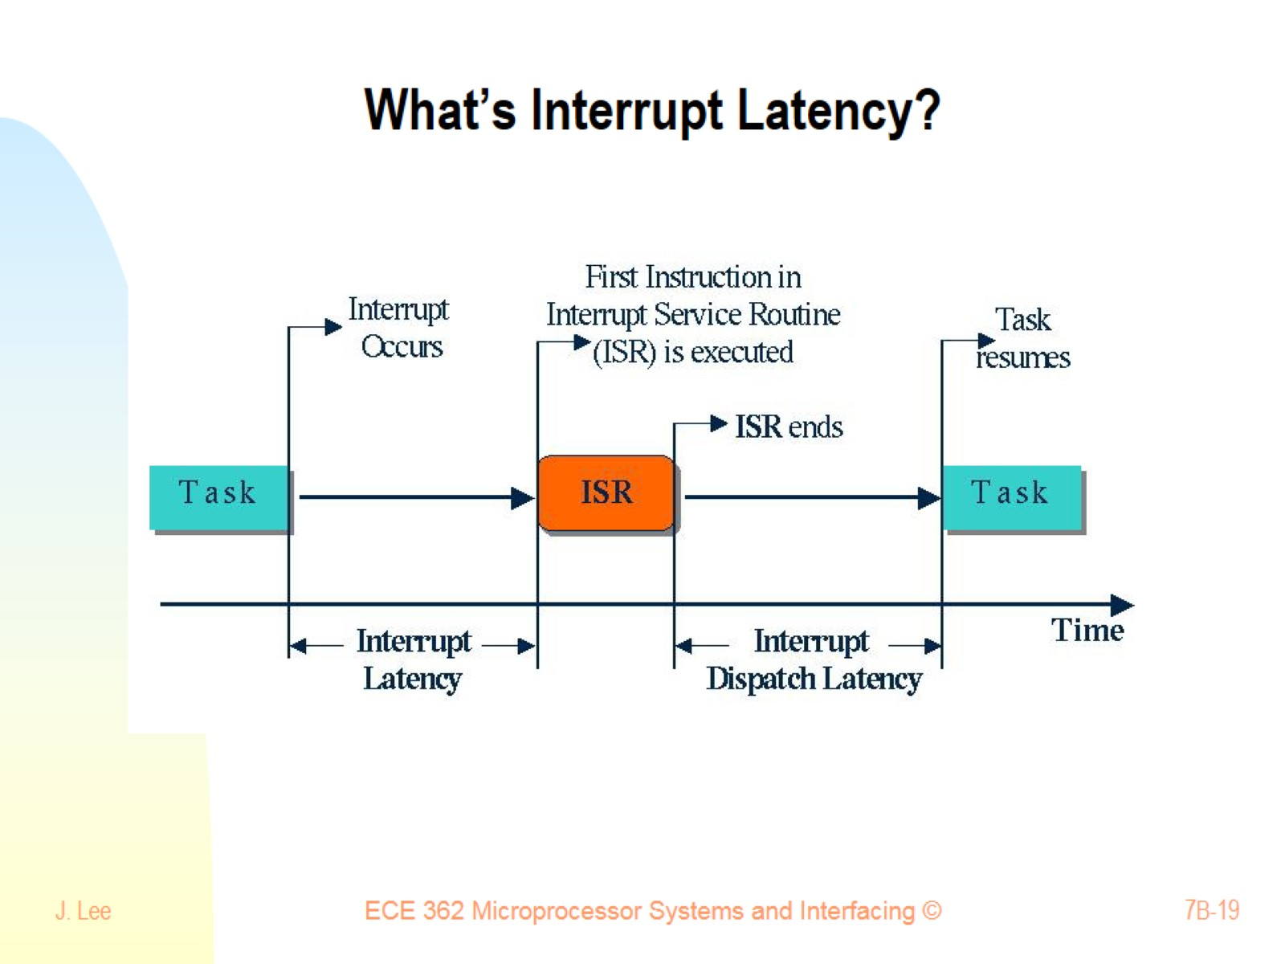
What’s Interrupt Latency?

Slide 20
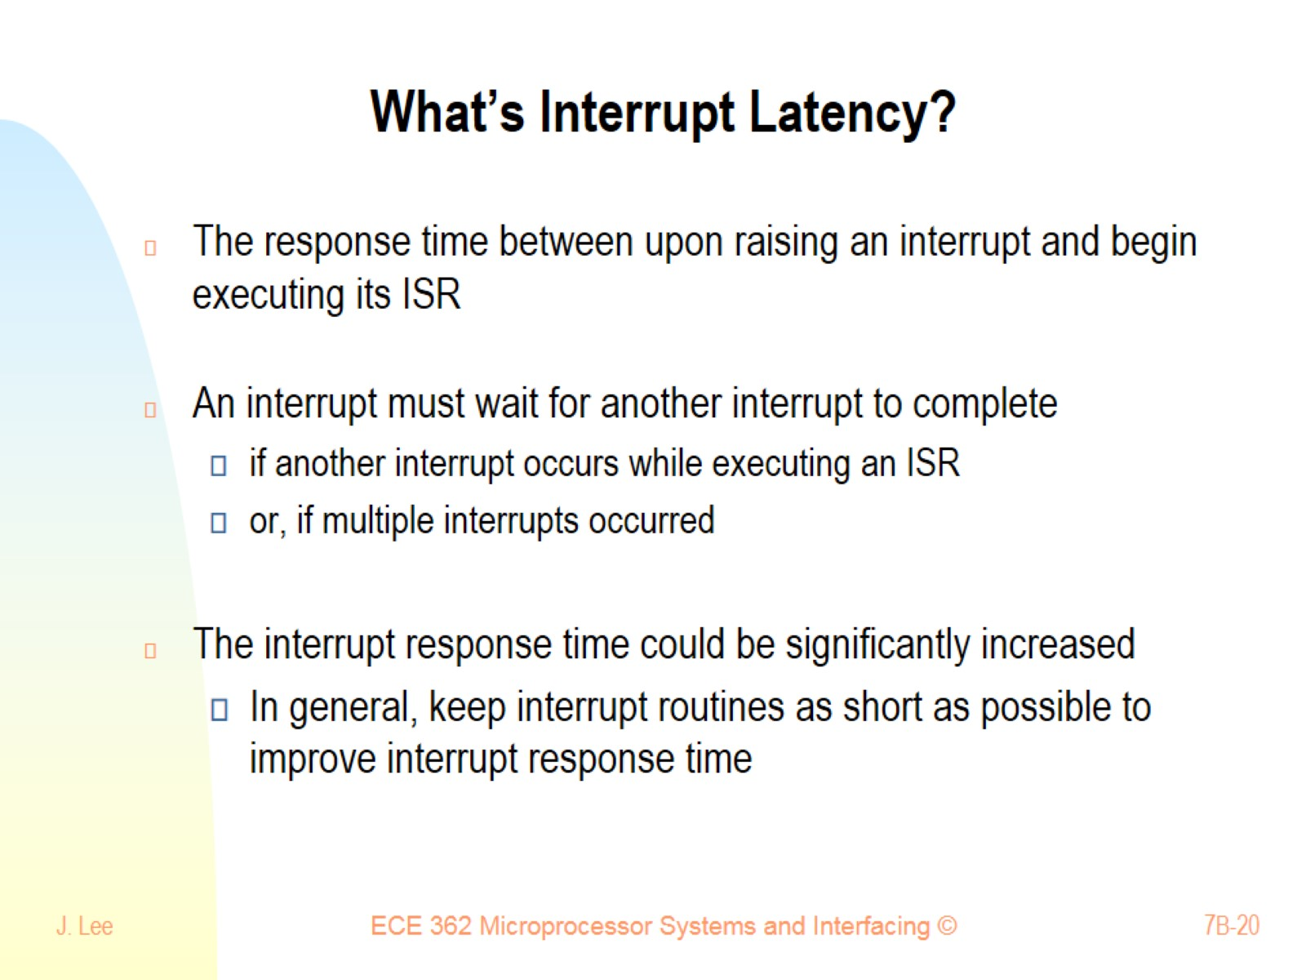
What’s Interrupt Latency?

Slide 21
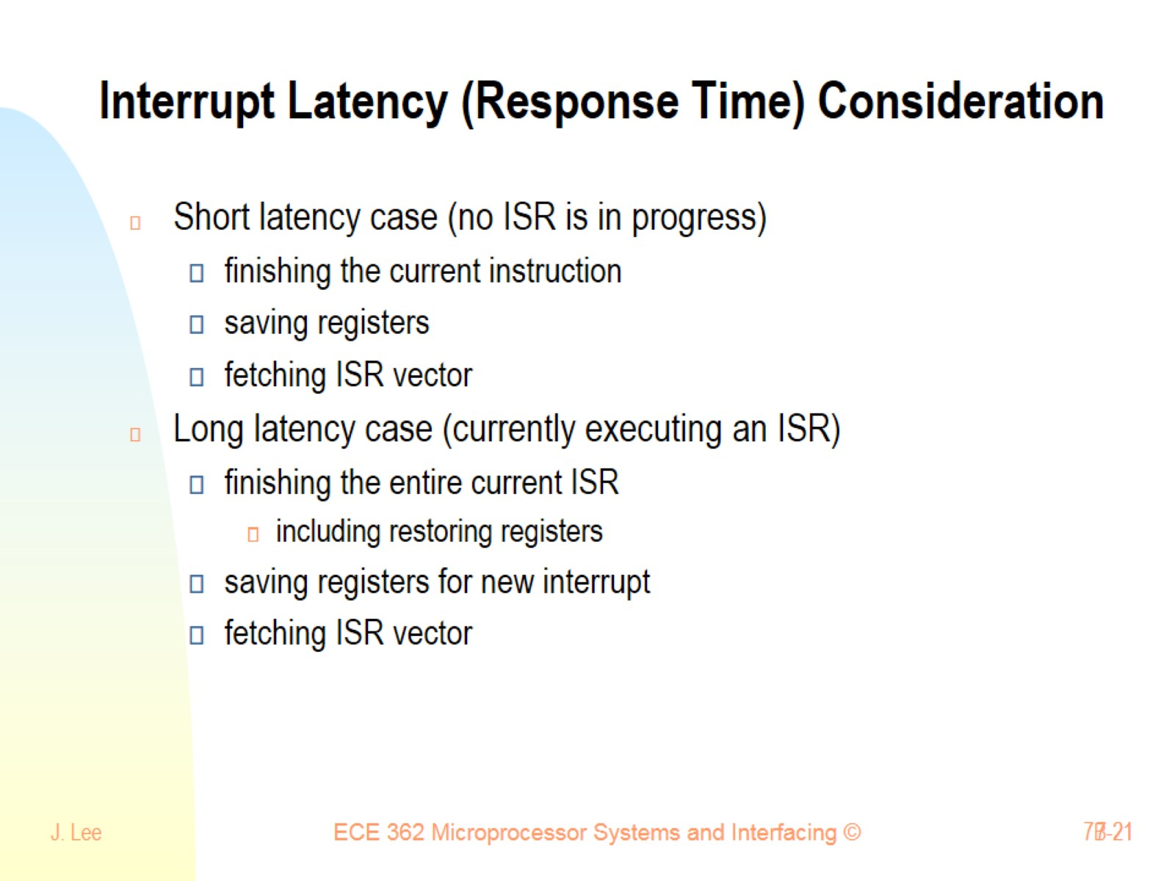
Interrupt Latency (Response Time) Consideration

Slide 22
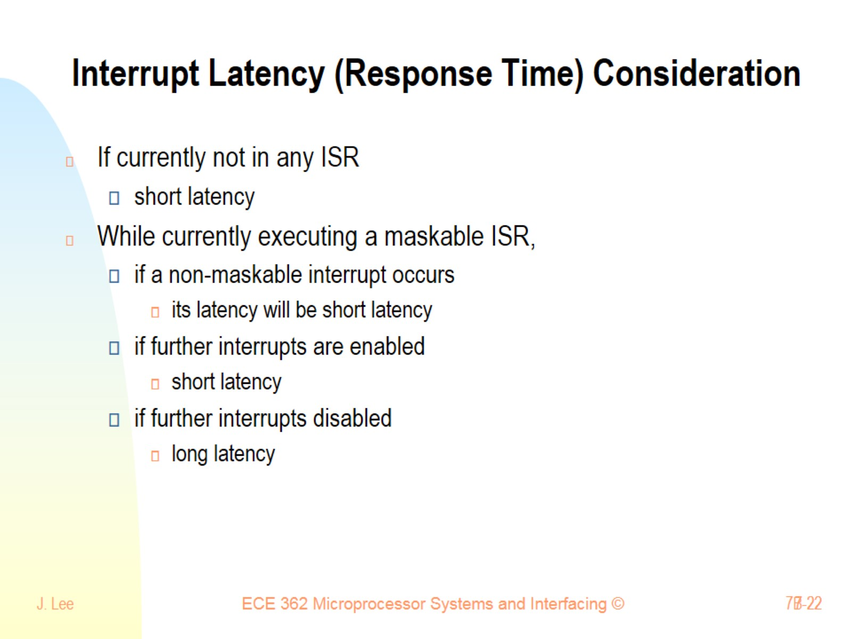
Interrupt Latency (Response Time) Consideration

Slide 23
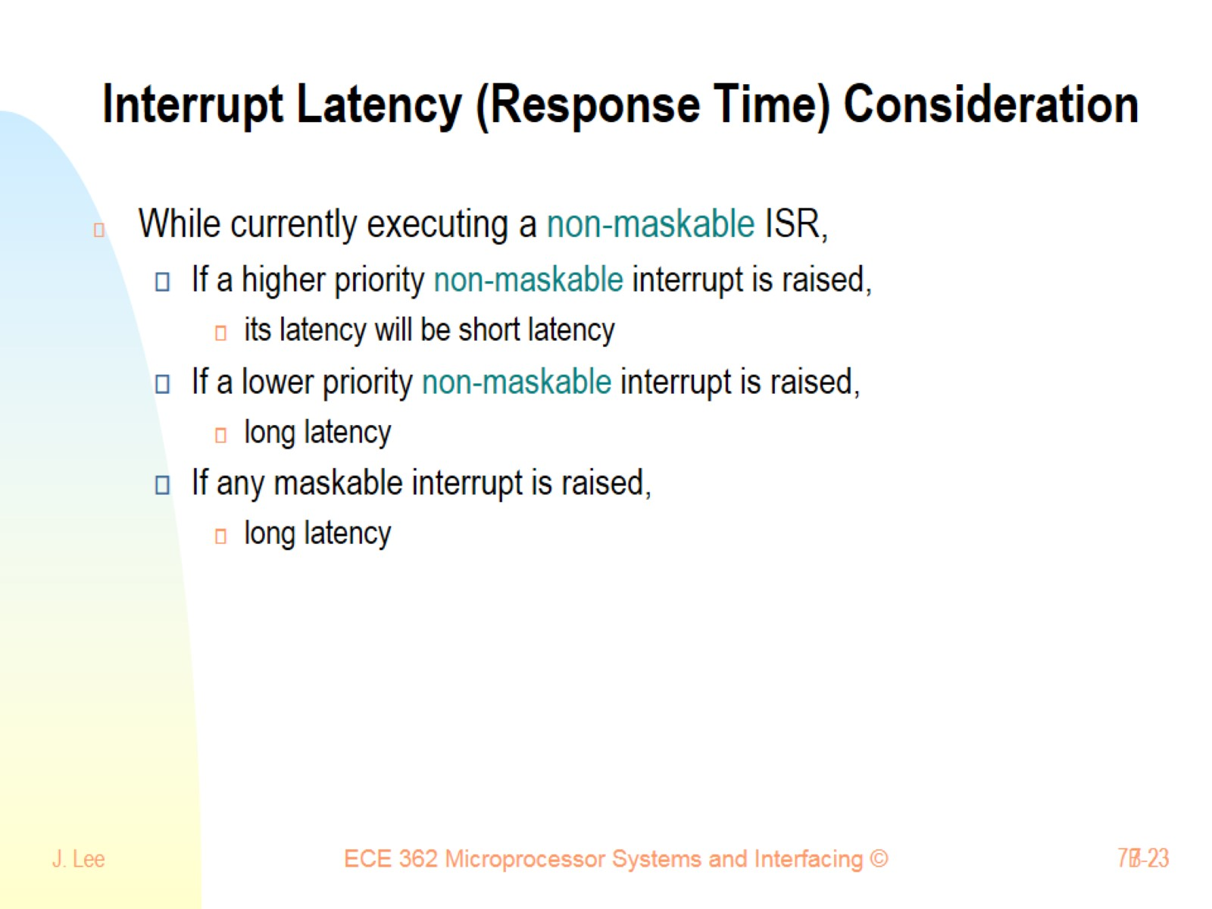
Interrupt Latency (Response Time) Consideration

